Slide 1

Using Digital Tools
to Improve My
Learning Workflow
Student Name: M.T. Darshani
Student ID: PSBUC/DIP/ICT/SL/26/LC/0015
Diploma in ICT | Assignment 01
March 2026

Slide 2

Password Strategy
Use strong passwords (8–12 characters)
• Mix letters, numbers, symbols
• Avoid personal info
• Use different passwords
• Change regularly
• Keep passwords private

Slide 3

Phishing Awareness
Avoid suspicious links/emails
• Check sender address
• Don't download unknown files
• Look for spelling mistakes
• Never share personal info
• Ask when unsure

Slide 4
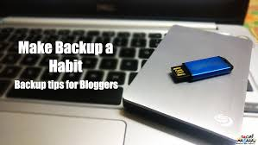
Backup Habits
Save files regularly
• Use USB or cloud storage
• Keep copies of school work
• Backup weekly
• Store safely

Slide 5
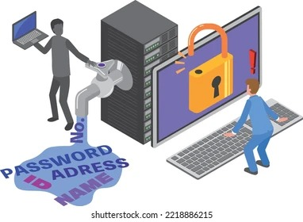
Safe Downloads
Trusted websites only
Avoid pirated content
Scan for viruses
Scan Before Opening
Extension Check

Slide 6
Personal Action Plan
Action Item | Frequency | Goal
Software Updates | Weekly | Patch security vulnerabilities immediately.
Privacy Audit | Monthly | Review social media settings and app permissions.
MFA Check | Immediate | Ensure all "Primary" accounts have 2FA enabled.
Public Wi-Fi | Ongoing | Use a VPN or mobile hotspot for schoolwork in cafes.

